Slide 1
Into the Portal

Slide 2
INDEX
AD STORE
TEMPLATE
DESIGN
ILLUST
SPACE
PORTAL
ABSTRACT

Slide 3
INDEX
DESIGN
ILLUST
SPACE
PORTAL
ABSTRACT
AD STORE
TEMPLATE

Slide 4
Into the Portal
Contents Title

Slide 5
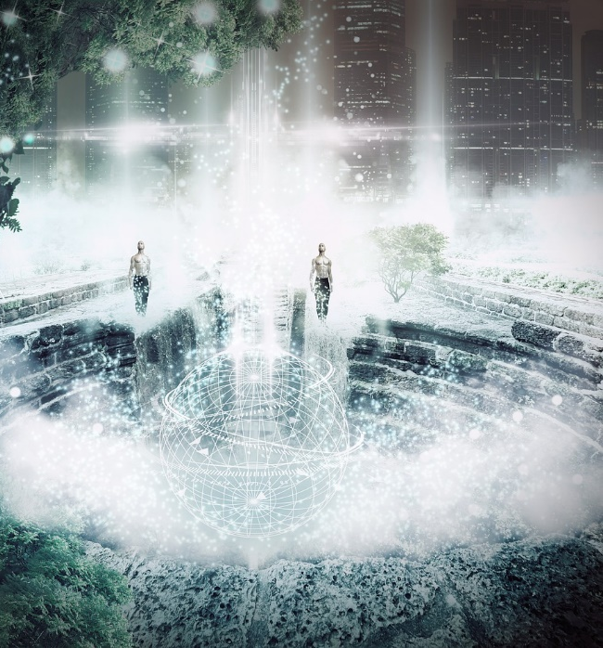
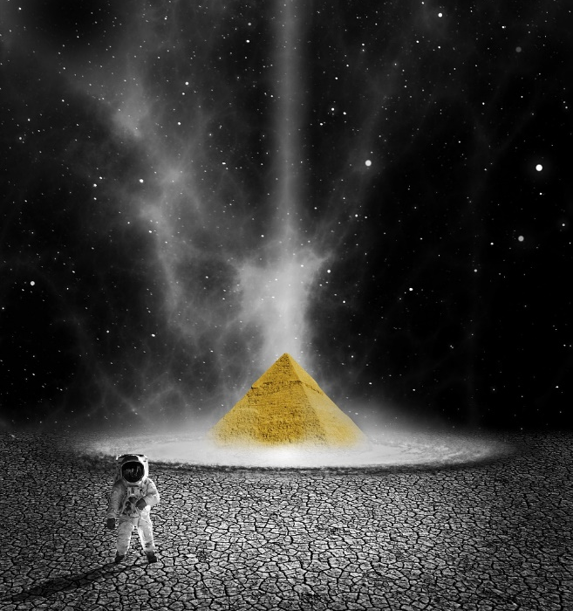
INTO THE PORTAL
INTO THE PORTAL
ADSTORE PT TEMPLATE
ADSTORE
PT
DESIGN
How lovely are the portals of the night,
when stars come out
to watch the daylight die.
Look at the sky. We are not alone.
The whole universe is friendly to us and
conspires only to give the best to
those who dream and work.

Slide 6
Into the Portal

Slide 7
INDEX
AD STORE
TEMPLATE
FOLLOW
ME
SPACE
PORTAL
ABSTRACT

Slide 8
INDEX
ADSTORE
TEMPLATE
DESIGN
ILLUST
SPACE
PORTAL
ABSTRACT

Slide 9
Into the Portal
Contents Title

Slide 10
INTO THE PORTAL
INTO THE PORTAL
ADSTORE PT TEMPLATE
ADSTORE
PT
DESIGN
How lovely are the portals of the night,
when stars come out
to watch the daylight die.
Look at the sky. We are not alone.
The whole universe is friendly to us and
conspires only to give the best to
those who dream and work.

