Slide 1
PT TEMPLATE PURE RED+ WHITE
ADSTORE FREE TEMPLATE

Slide 2
IN. DE. ..X
CONTENTS
DESIGN
TRENDS
PROMOTION

Slide 3
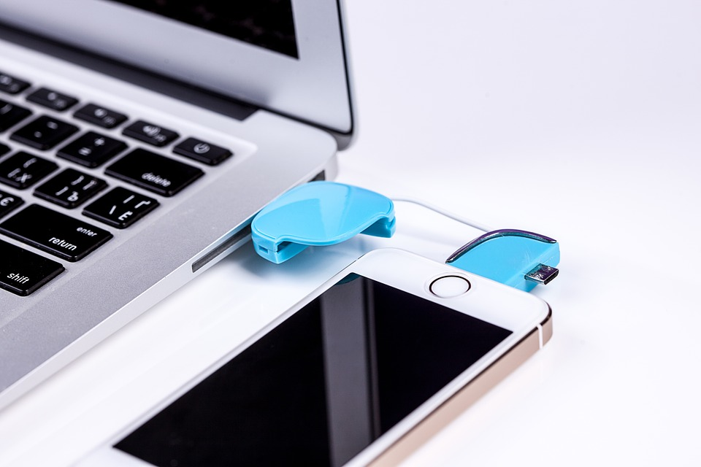
DESIGNED BY ADSTOREPOST.COM
PT DESIGN
PURE
RED+
WHITE
BASIC POWERPOINT PT DESIGN
CONTENTS
Start by doing what's necessary; then do what's possible; and suddenly you are doing the impossible.
- Francis of Assisi

Slide 4
DESIGNED BY ADSTOREPOST.COM
우리의
안전지대
OUR
SAFETY
ZONE
BASIC POWERPOINT PT DESIGN
CONTENTS
The best preparation
for tomorrow is
doing your best today.
- H. Jackson Brown, Jr.
ADSTOREPOST

Slide 5
CON TEN TS.
DSEIGNED
B.Y
ADSTORE

