Slide 1
El Dorado
ADSTOREPOWERPOINT

Slide 2
El Dorado
ADSTOREPOWERPOINT

Slide 3
El Dorado
ADSTOREPOWERPOINT

Slide 4
El Dorado
Introduction
Adstore
Design
Tutorial
Images
FAQ
ADSTOREPOWERPOINT

Slide 5
Designed by Studio L@rgo
El Dorado
Design
All that is gold does not glitter, not all those who wander are lost; the old that is strong does not wither, deep roots are not reached by the frost.
= J. R. R Tolkien

Slide 6
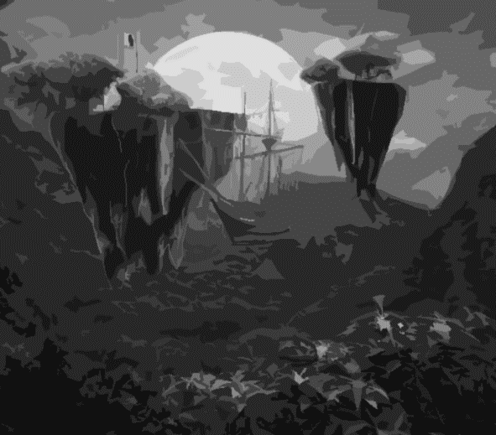
Designed by Studio L@rgo
El Dorado
The proper study of Man is anything but Man; and the most improper job of any man, even saints (who at any rate were at least unwilling to take it on), is bossing other men. Not one in a million is fit for it, and least of all those who seek the opportunity.
- J. R. R. Tolkien
Design

Slide 7
Designed by Studio L@rgo
El Dorado
If more of us valued food and cheer and song above hoarded gold, it would be a merrier world.
- J. R. R. Tolkien
Design

Slide 8
Designed by Studio L@rgo
The Road to El Dorado
It is plain indeed that in spite of later estrangement Hobbits are relatives of ours: far nearer to us than Elves, or even than Dwarves. Of old they spoke the languages of Men, after their own fashion, and liked and disliked much the same things as Men did. But what exactly our relationship is can no longer be discovered.
J. R. R. Tolkien
Designed by Studio L@rgo
Instagram.com/Largo_adstore
Facebook.com/adstorepost
Adstorepost.com

